Slide 1


Credit Card Fraud Detection
01

Slide 2

Team Members
Mr. Mohammad Fares (Data Scientist)
Mr. Mohammad Nasser (Software Architect)
Ms. Asma Jabr (Data Engineer)
Ms. Duha Jarrar (Software Engineer)
Ms. Sanaa Laimoun (Business Development)
Ms. Sahar Shehadeh (Business Development)
02

Slide 3

Project Scope
Explore credit card data set (Kaggel DS used for development purposes)
Provide relevant docs SRS – Business Plan – Data Management
Develop credit card fraud detection through applying ML.
Deploy expected product on production environment.
03

Slide 4

Problem
Direct revenue loss in financial entities and their customers as banks, e-payment gateways, e-wallets ..etc. through violating security rules & regulations.
04

Slide 5


Solution
Develop early detection system to discover fraudsters on real time transactions.
Notifications (SMS, Call, e-mail) to business owner on potential fraud transactions.
Provide needed reports, dashboards that help top management to take right decision in their business scenarios.
05

Slide 6
Business Model
SaaS
Micro-service - subscriptions
SaaP
Standalone product – applicable to be integrated.
perpetual license
Central SaaP
Palestine Monetary Authority
We have three suggested business models:
06

Slide 7






Data Collection
Data Organization, Documentation and Metadata
Data Management Plan
Data Access and Intellectual Property
Components
Data Sharing and Reuse
Data Preservation and Archiving
07

Slide 8
Data Collection
Kaggel DS - 492 frauds out of 284,807 transactions.
Imbalanced DS – Fraud cases is 0.172% of total transactions.
It contains only numerical input variables which are the result of a PCA transformation. .
After the establishment of the start-up, we will use the record review method for systematic data collection from existing records, as our clients are banks, e-pay agencies, and credit card vendors.
The type of data will be Quantitative tabular data (CSV) file .
For the first 2 years, the data size will be between (3-10) TB with a rate of growth 20% annually. The data analytical tool will be used to interpret and manipulate data is Python v.3.
08

Slide 9
Data Organization, Documentation and Metadata
Metadata for the current Dataset that we used
Usage Information | License | Database: Open Database, Contents: Database Contents Visibility
 | Visibility | Public
Maintainers | Dataset owner | Machine Learning Group - ULB
Updates
 | Expected update frequency | Not specified
 | Last updated | 2018-03-23
 | Date created | 2016-11-03
 | Current version | Version 3
09

Slide 10
Data Organization, Documentation and Metadata
Our Metadata
Dataset ID | CC _Fraud_PAL
Format | comma-separated values (CSV) file
Publication Date | 2021-06-1
Title | Credit Card Fraud Detection
Authors | Sanaa’ Laimoun, Sahar Shehadeh, Asmaa’ Duha, Mohammad Nasser, Mohammad Fares.
Contact | Credit.card@gmail.ps (example)
Description | The project involves development of a predictive and prescriptive analytics software for detecting fraudulent transactions in real-time, high speeds and with high accuracy. The data will contain only numerical input variables which will be the result of a PCA transformation.
Subject | Financial Institutions; Banking and Finance; Crime; Business; Computer and Information Science; Software Engineering.
Keywords | Fraud, detection, credit card
Location | Palestine
Use of the Data | The data may be used for further research on the Credit Card Fraud in Palestine, further investigation, to set as a baseline in Palestine, for validation and verification, and citation.
Restrictions | Due to confidentiality issues, we cannot provide the original features and more background information about the data.
Note | The authors would like to thank Center for Continuing Education - Birzeit University for their support.
Depositor | N/A
Deposit Date | 2021-06-1
Dataset Persistent ID | CC _Fraud_PAL
10

Slide 11
Data Access and Intellectual Property
Always three persons from the partners have access to the data drive files, which assures access anytime.
Students, researchers who use the data governed by a contract to ensure confidentiality and publication rights.
Confidential data will be stored in the secure facilities.
All personal details will be replaced with ID codes.
All metadata will be uploaded onto data center storage and sharing facility specifically dedicated to this project.
There are two levels of intellectual property :
1) Joint intellectual property, owned by partners ( algorithms and codes for the system).
2) Publicly available intellectual property no restrictions (published documents, website data).
11

Slide 12
Data Sharing and Reuse
Due to the data sensitivity of credit card holders, identities details will be excluded.
During the project duration, data are only accessible by partners in the way described before.
After the project duration, students or interested researcher can only work with the data after signing a contract that arranges confidentially and publication rights.
The data share and re-use governed by decision of the partners.
Data disclosure, the reasons should be mentioned (e.g. ethical, rules of personal data, intellectual property, commercial, privacy-related, security-related).
12
Notes:
Due to the data sensitivity of credit card holders, identities details will be excluded.
During the project duration, data are only accessible by partners in the way described before. After the project duration, students or interested researcher can only work with the data after signing a contract that arranges confidentially and publication rights.
The data will be available for share and re-use upon decision of the partners, in order to avoid issues related to IP rights protection or access or regulations. Once the data are made openly available they will remain open and up-to-date.
In case that the dataset cannot be shared, the reasons for this should be mentioned (e.g. ethical, rules of personal data, intellectual property, commercial, privacy-related, security-related).

Slide 13
Data Preservation and Archiving
For learning purposes – data will be available on the internet with “CSV” format.
Data Repositories:
Local options: hard drive/tapes, distributed GEO locations.
Cloud-based options: Local DC or Global DC as AWS.
The IT Manager will be responsible for data storage, security, accessibility, availability, scalability, fail-over strategies and overall performance.
13
Notes:
All relevant obtained data will be preserved and archived permanently using csv format in a disciplinary repository to make it more widely accessible and citable.
A distributed approach to storing the data will be conducted:
Local options: such as internal hard drive (computer hard drive), external hard drives, and local server.
Cloud-based options: such as Amazon Web Services.
The IT Manager will be responsible for ensuring that data permissions have been correctly assigned and for advising on other aspects of data storage and security.

Slide 14
Data Sourcing & Properties
284808 creditcard.csv
Fraud detection Kaggel data set.
creditcard.csv with shape (284807, 31).
Dimensions – [Time, V1, V2 … V28, Amount, Class] -.
No empty values, zero null values.
Imbalanced data set, almost all records don’t represent fraud cases (492 fraud cases out of 284315).
13
Notes:
All relevant obtained data will be preserved and archived permanently using csv format in a disciplinary repository to make it more widely accessible and citable.
A distributed approach to storing the data will be conducted:
Local options: such as internal hard drive (computer hard drive), external hard drives, and local server.
Cloud-based options: such as Amazon Web Services.
The IT Manager will be responsible for ensuring that data permissions have been correctly assigned and for advising on other aspects of data storage and security.

Slide 15
Data Preparation
284808 creditcard.csv
No missing data to be processed.
Some dimensions will be dropped after EDA as it has no effect on fraud classification.
Imbalanced data will be processed as listed in the coming slide.
Data Segregation:
Validation dataset = 56962
Training data = 227845
Percentage = 20.000210668979342%
13
Notes:
All relevant obtained data will be preserved and archived permanently using csv format in a disciplinary repository to make it more widely accessible and citable.
A distributed approach to storing the data will be conducted:
Local options: such as internal hard drive (computer hard drive), external hard drives, and local server.
Cloud-based options: such as Amazon Web Services.
The IT Manager will be responsible for ensuring that data permissions have been correctly assigned and for advising on other aspects of data storage and security.

Slide 16
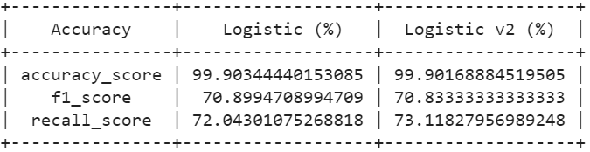
Data Preprocessing .. Dimension Drop
284808 creditcard.csv
[ V13, V20, V23] had been dropped, irrelevant dimensions.
Observations: Excluding irrelevant shows minor enhancement in accuracy.
13
Notes:
All relevant obtained data will be preserved and archived permanently using csv format in a disciplinary repository to make it more widely accessible and citable.
A distributed approach to storing the data will be conducted:
Local options: such as internal hard drive (computer hard drive), external hard drives, and local server.
Cloud-based options: such as Amazon Web Services.
The IT Manager will be responsible for ensuring that data permissions have been correctly assigned and for advising on other aspects of data storage and security.

Slide 17
Data Preprocessing .. Imbalanced DS
Five methods to handle imbalanced DS:
Change the performance metric
Change the algorithm
Oversample minority class
Under sample majority class
Generate synthetic samples
13
Notes:
All relevant obtained data will be preserved and archived permanently using csv format in a disciplinary repository to make it more widely accessible and citable.
A distributed approach to storing the data will be conducted:
Local options: such as internal hard drive (computer hard drive), external hard drives, and local server.
Cloud-based options: such as Amazon Web Services.
The IT Manager will be responsible for ensuring that data permissions have been correctly assigned and for advising on other aspects of data storage and security.

Slide 18
Data Preprocessing .. Imbalanced DS
1. Change the performance metric:
These scores don’t look quite so impressive.
accuracy_score= 0.9990344440153085
f1_score= 0.6783625730994152
recall_score= 0.6041666666666666
2. Change the algorithm
While our accuracy score is slightly lower, both F1 and recall have increased as compared to logistic regression! It appears that for this specific problem, random forest may be a better choice of model.
13
Notes:
All relevant obtained data will be preserved and archived permanently using csv format in a disciplinary repository to make it more widely accessible and citable.
A distributed approach to storing the data will be conducted:
Local options: such as internal hard drive (computer hard drive), external hard drives, and local server.
Cloud-based options: such as Amazon Web Services.
The IT Manager will be responsible for ensuring that data permissions have been correctly assigned and for advising on other aspects of data storage and security.

Slide 19
Data Preprocessing .. Imbalanced DS
3. Resampling Techniques — Oversample minority class:
Our recall score increased, but F1 is much lower than with either our
baseline logistic regression or random forest from above
4. Resampling techniques — Under sample majority class:
Again, we would split into test and train sets BEFORE trying Under sample techniques
5. Generate synthetic samples SMOTE
accuracy_score= 0.9858571388444145
f1_score= 0.18461538461538463
recall_score= 0.8636363636363636
Conclusion: forest and SMOTE are the best of the options we tried here.
13
Notes:
All relevant obtained data will be preserved and archived permanently using csv format in a disciplinary repository to make it more widely accessible and citable.
A distributed approach to storing the data will be conducted:
Local options: such as internal hard drive (computer hard drive), external hard drives, and local server.
Cloud-based options: such as Amazon Web Services.
The IT Manager will be responsible for ensuring that data permissions have been correctly assigned and for advising on other aspects of data storage and security.

Slide 20
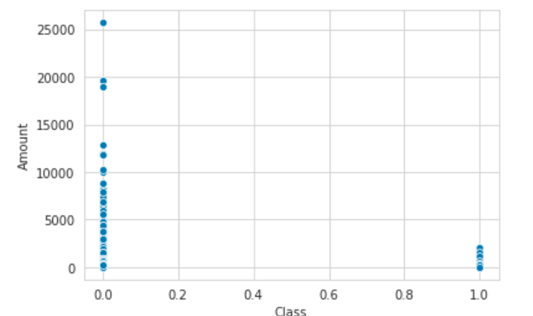
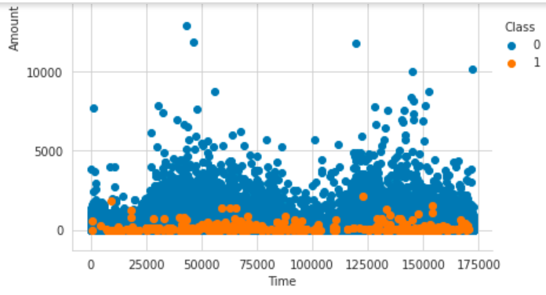
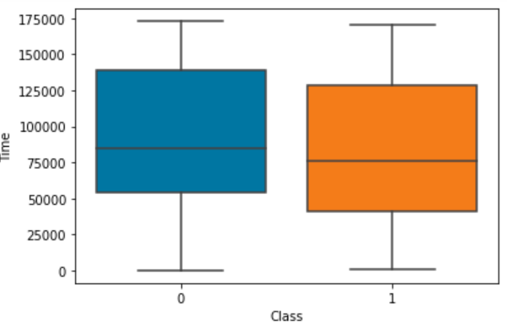
EDA
From above box plot we can easily infer that there are no fraud transactions occur
above the transaction amount of 3000. All of the fraud transactions have transaction
amount less than 3000. However, there are many transactions which have a transaction
amount greater than 3000 and all of them are genuine.
We used the plot above to check the distribution of observations for each feature and one by one,
for example V4: shows clear distinction between fraud & genuine transactions, while V28 didn't.
13
Notes:
All relevant obtained data will be preserved and archived permanently using csv format in a disciplinary repository to make it more widely accessible and citable.
A distributed approach to storing the data will be conducted:
Local options: such as internal hard drive (computer hard drive), external hard drives, and local server.
Cloud-based options: such as Amazon Web Services.
The IT Manager will be responsible for ensuring that data permissions have been correctly assigned and for advising on other aspects of data storage and security.

Slide 21
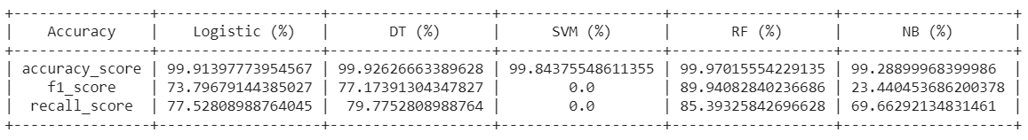
Model Selection
Used Models: Logistics, DT, SVM, RF, NB
Below snipped shows result per each model.
13
Notes:
All relevant obtained data will be preserved and archived permanently using csv format in a disciplinary repository to make it more widely accessible and citable.
A distributed approach to storing the data will be conducted:
Local options: such as internal hard drive (computer hard drive), external hard drives, and local server.
Cloud-based options: such as Amazon Web Services.
The IT Manager will be responsible for ensuring that data permissions have been correctly assigned and for advising on other aspects of data storage and security.

Slide 22
K-Fold Cross Validation
Split the fraud data set into K groups.
Choose one group as test set and others as training.
Train and calculate the accuracy.
Choose the next group as a test set and repeat.
Calculate average accuracy from all training rounds.
Apply K-Fold on all used ML algorithms
13
Notes:
All relevant obtained data will be preserved and archived permanently using csv format in a disciplinary repository to make it more widely accessible and citable.
A distributed approach to storing the data will be conducted:
Local options: such as internal hard drive (computer hard drive), external hard drives, and local server.
Cloud-based options: such as Amazon Web Services.
The IT Manager will be responsible for ensuring that data permissions have been correctly assigned and for advising on other aspects of data storage and security.

Slide 23


EMAIL
Fraud_det@ps
Let's work together
MOBILE
123-456-7890
MAILING ADDRESS
Ramallah,
Palestine
14

